Slide 1
sem project progress
Lokesh Venkatesh

Slide 2
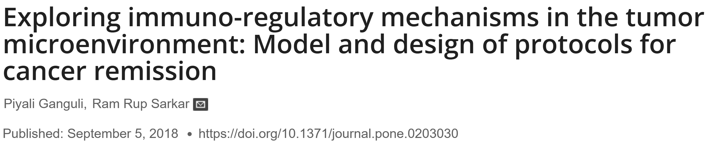
https://github.com/lokesh-venkatesh/TIME_Dynamics

Slide 3
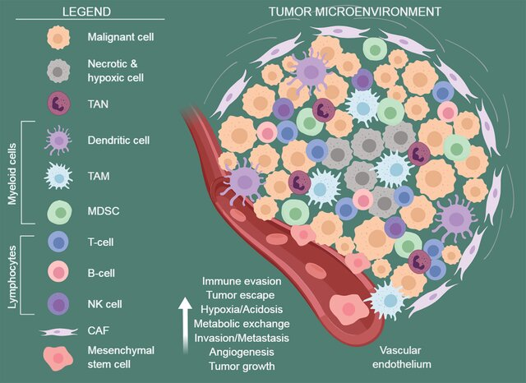
Modelling TIME interactions
Audrito et al., 2019 – Frontiers in Immunology`

Slide 4
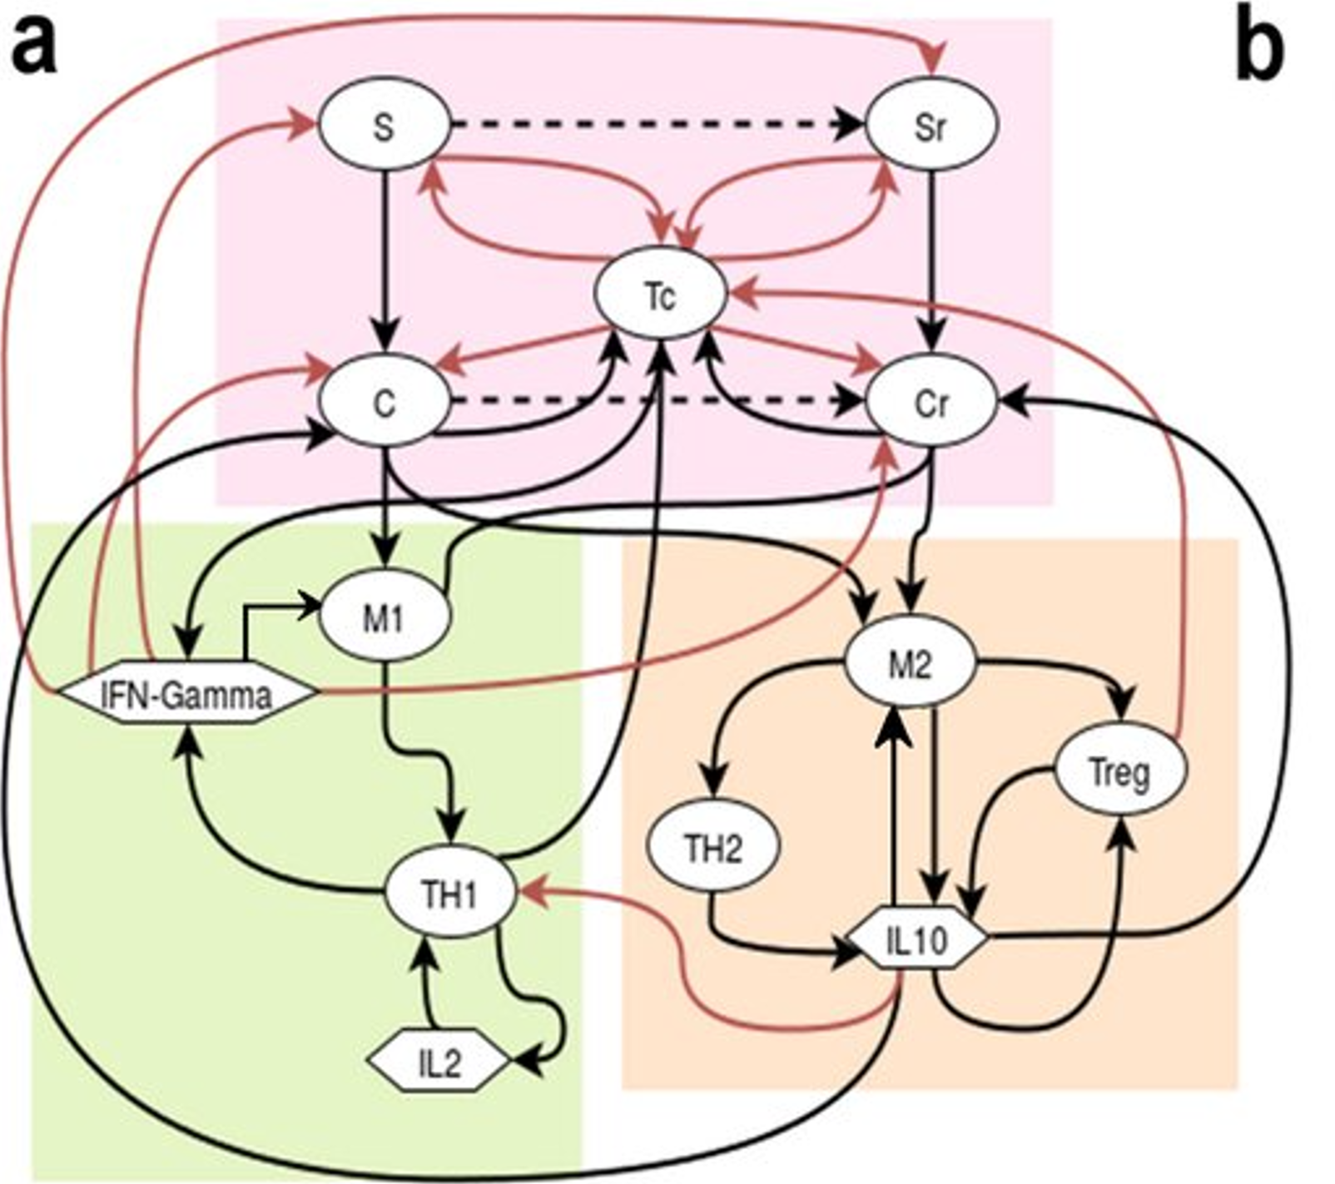

Ganguli & Sarkar, 2018 – PLOS ONE

Slide 5
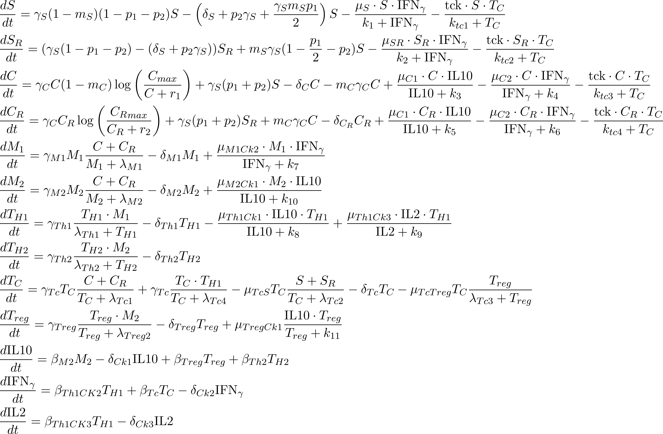

Slide 6
`
Parameters that were estimated using MCMC-DRAM

Slide 7
A few (random) biological details (?)
Differentiation (p1 and p2)
Temporal evolution for different parameters
Role of the TH1/TH2 ratio
Equilibrium state tumour size versus oscillatory dynamics
Difference between regular versus resistant cells

Slide 8
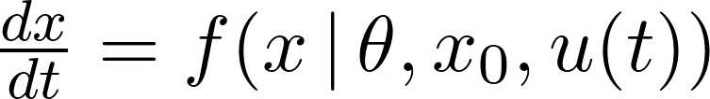

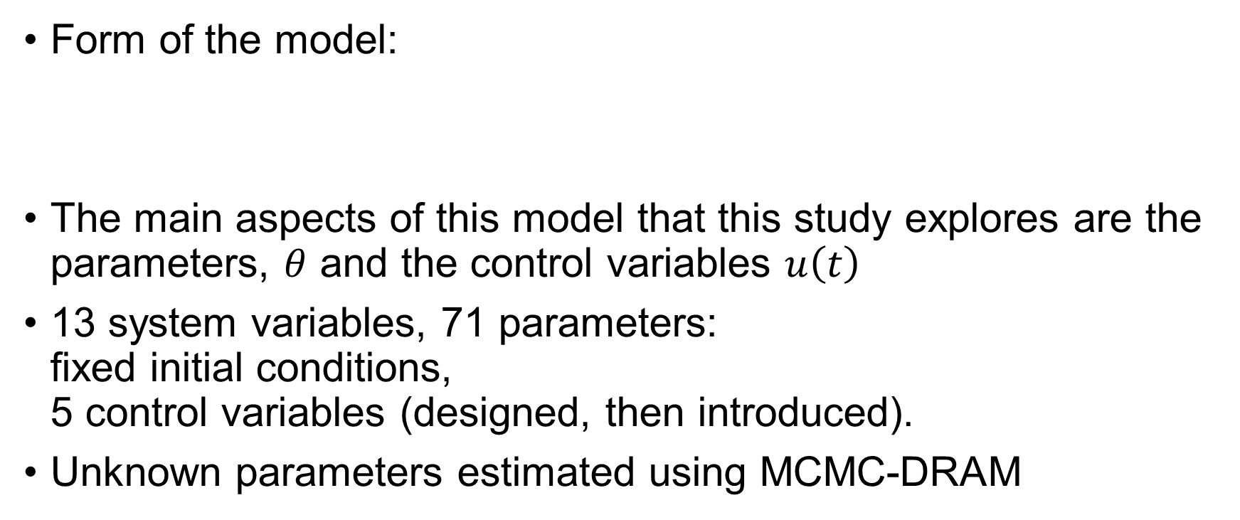
Tools/Methods
Form of the model:
The main aspects of this model that this study explores are the parameters, $θ$ and the control variables $u\left(t\right)$
13 system variables, 71 parameters: fixed initial conditions, 5 control variables (designed, then introduced).
Unknown parameters estimated using MCMC-DRAM

Slide 9
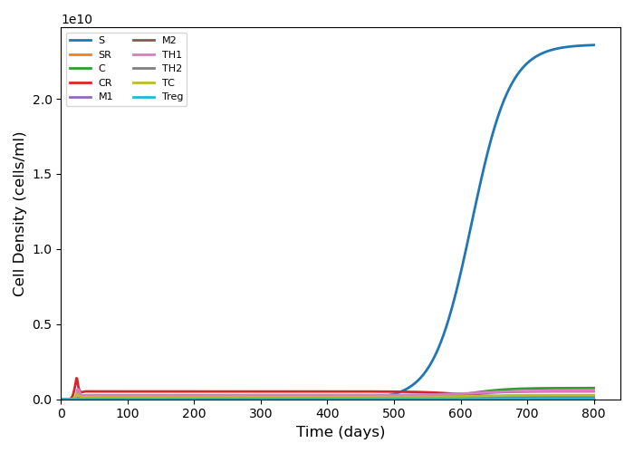
Simulation run with default parameters

Slide 10
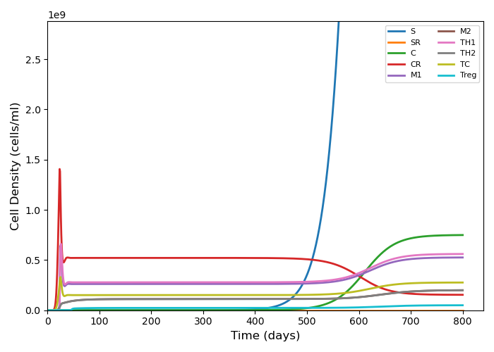

Slide 11
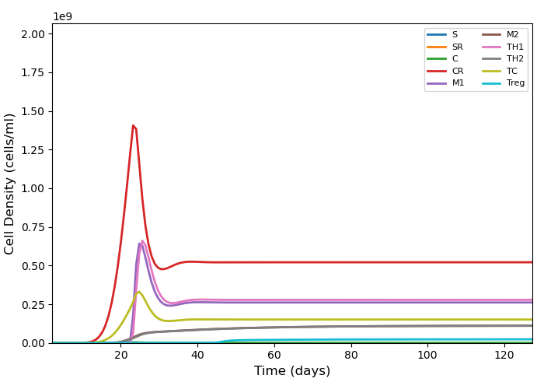

Slide 12
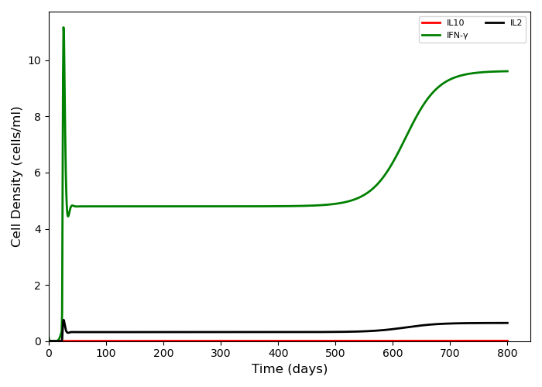

Slide 13
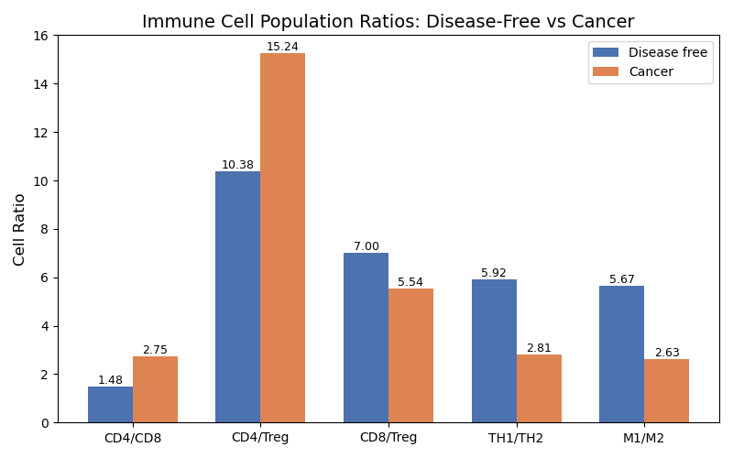
Cell population ratios
CD4 = TH1 + TH2;
CD8 = Tc.
TH1/TH2 and M1/M2 both lowered (good indicators of poor disease prognosis)

Slide 14
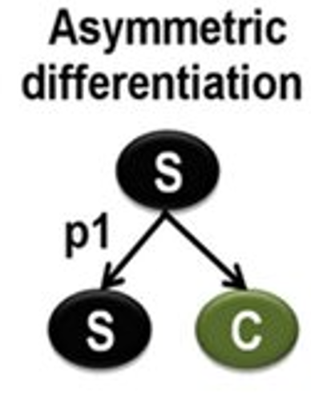
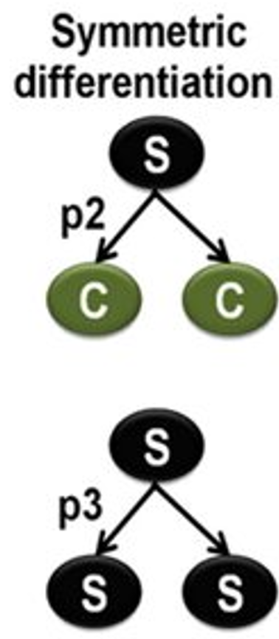
Cell division probabilities (and resulting cell types)

Slide 15
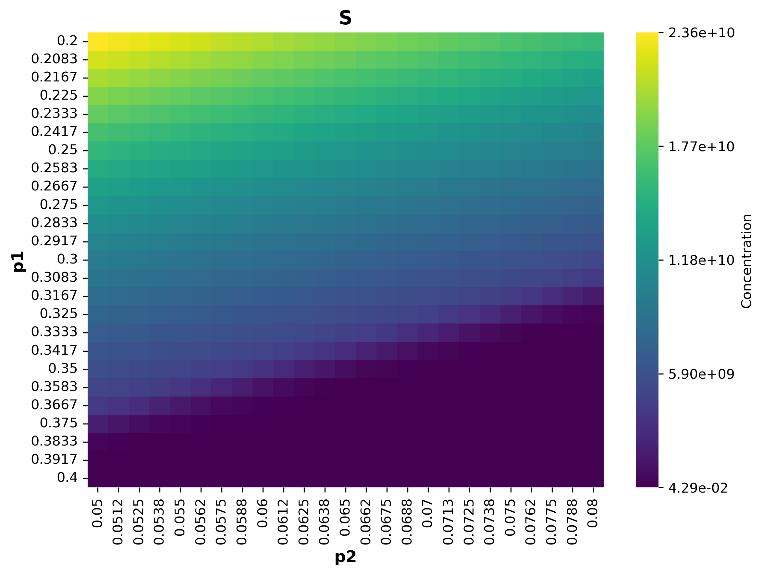
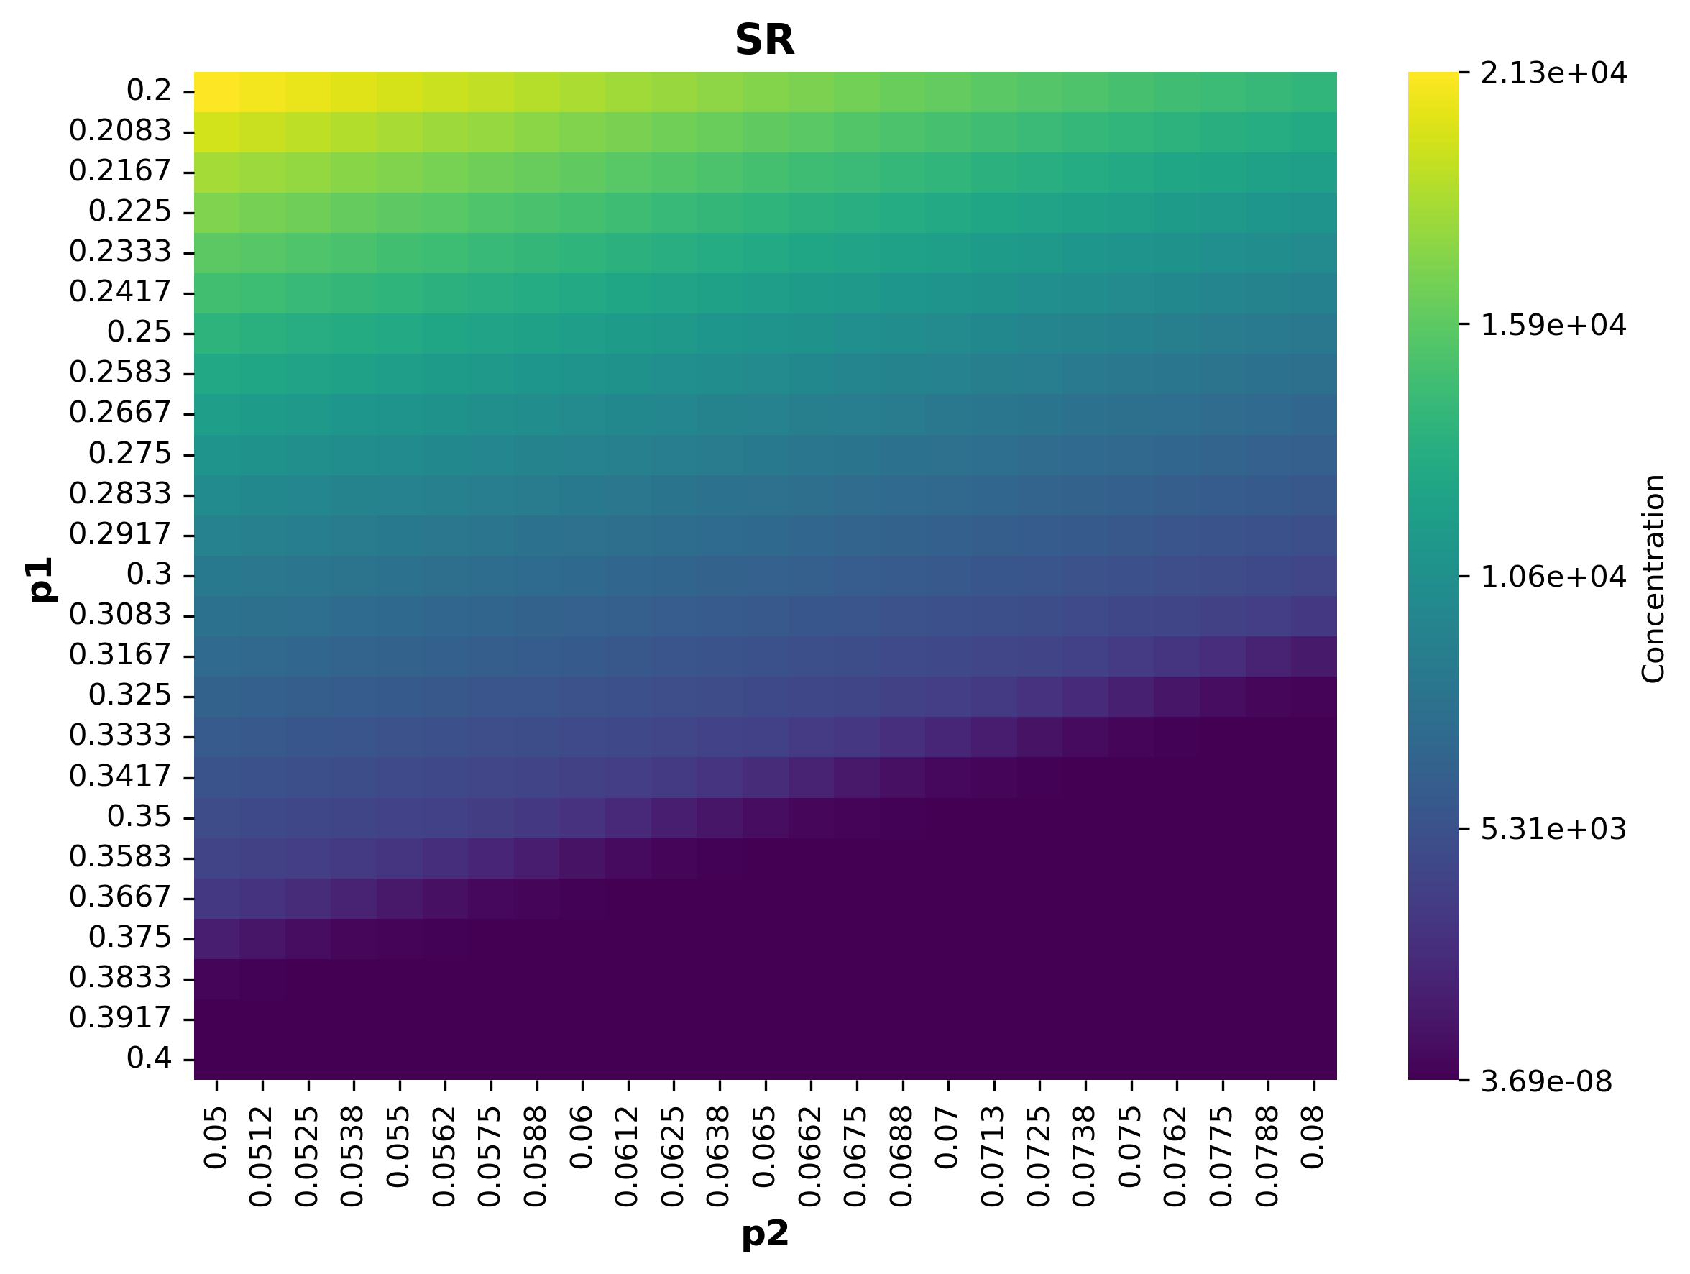
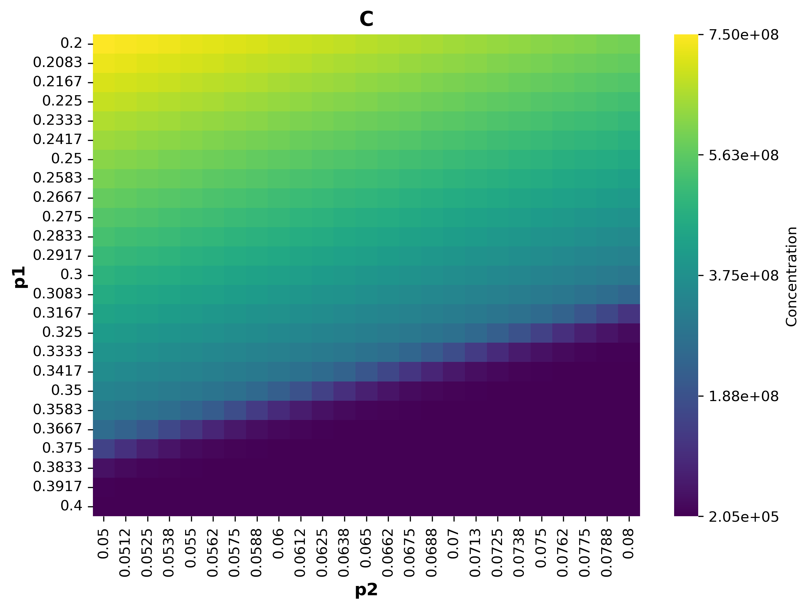
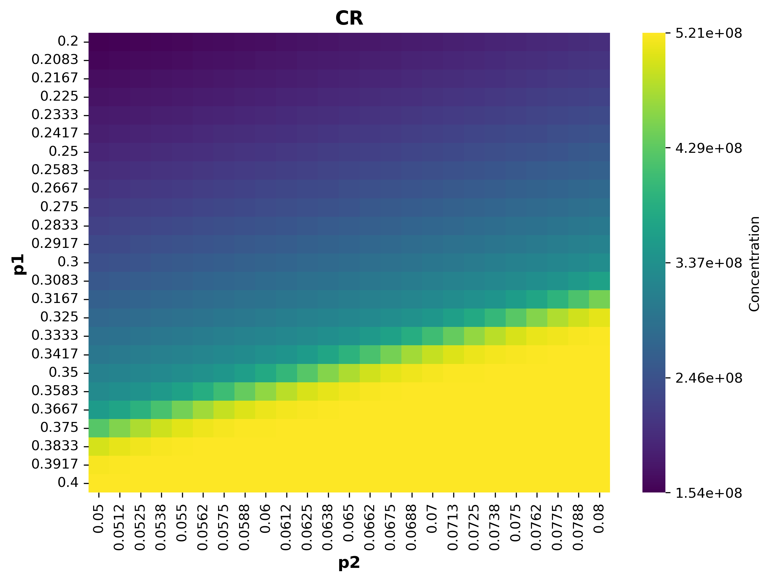
Probabilities of cellular differentiation

Slide 16
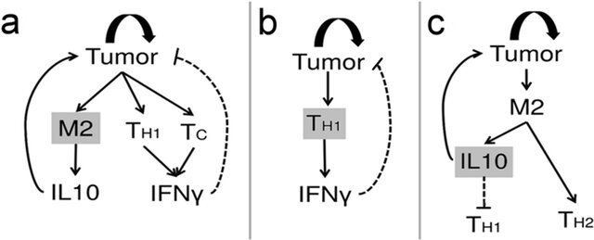
Other parameters of interest

Slide 17
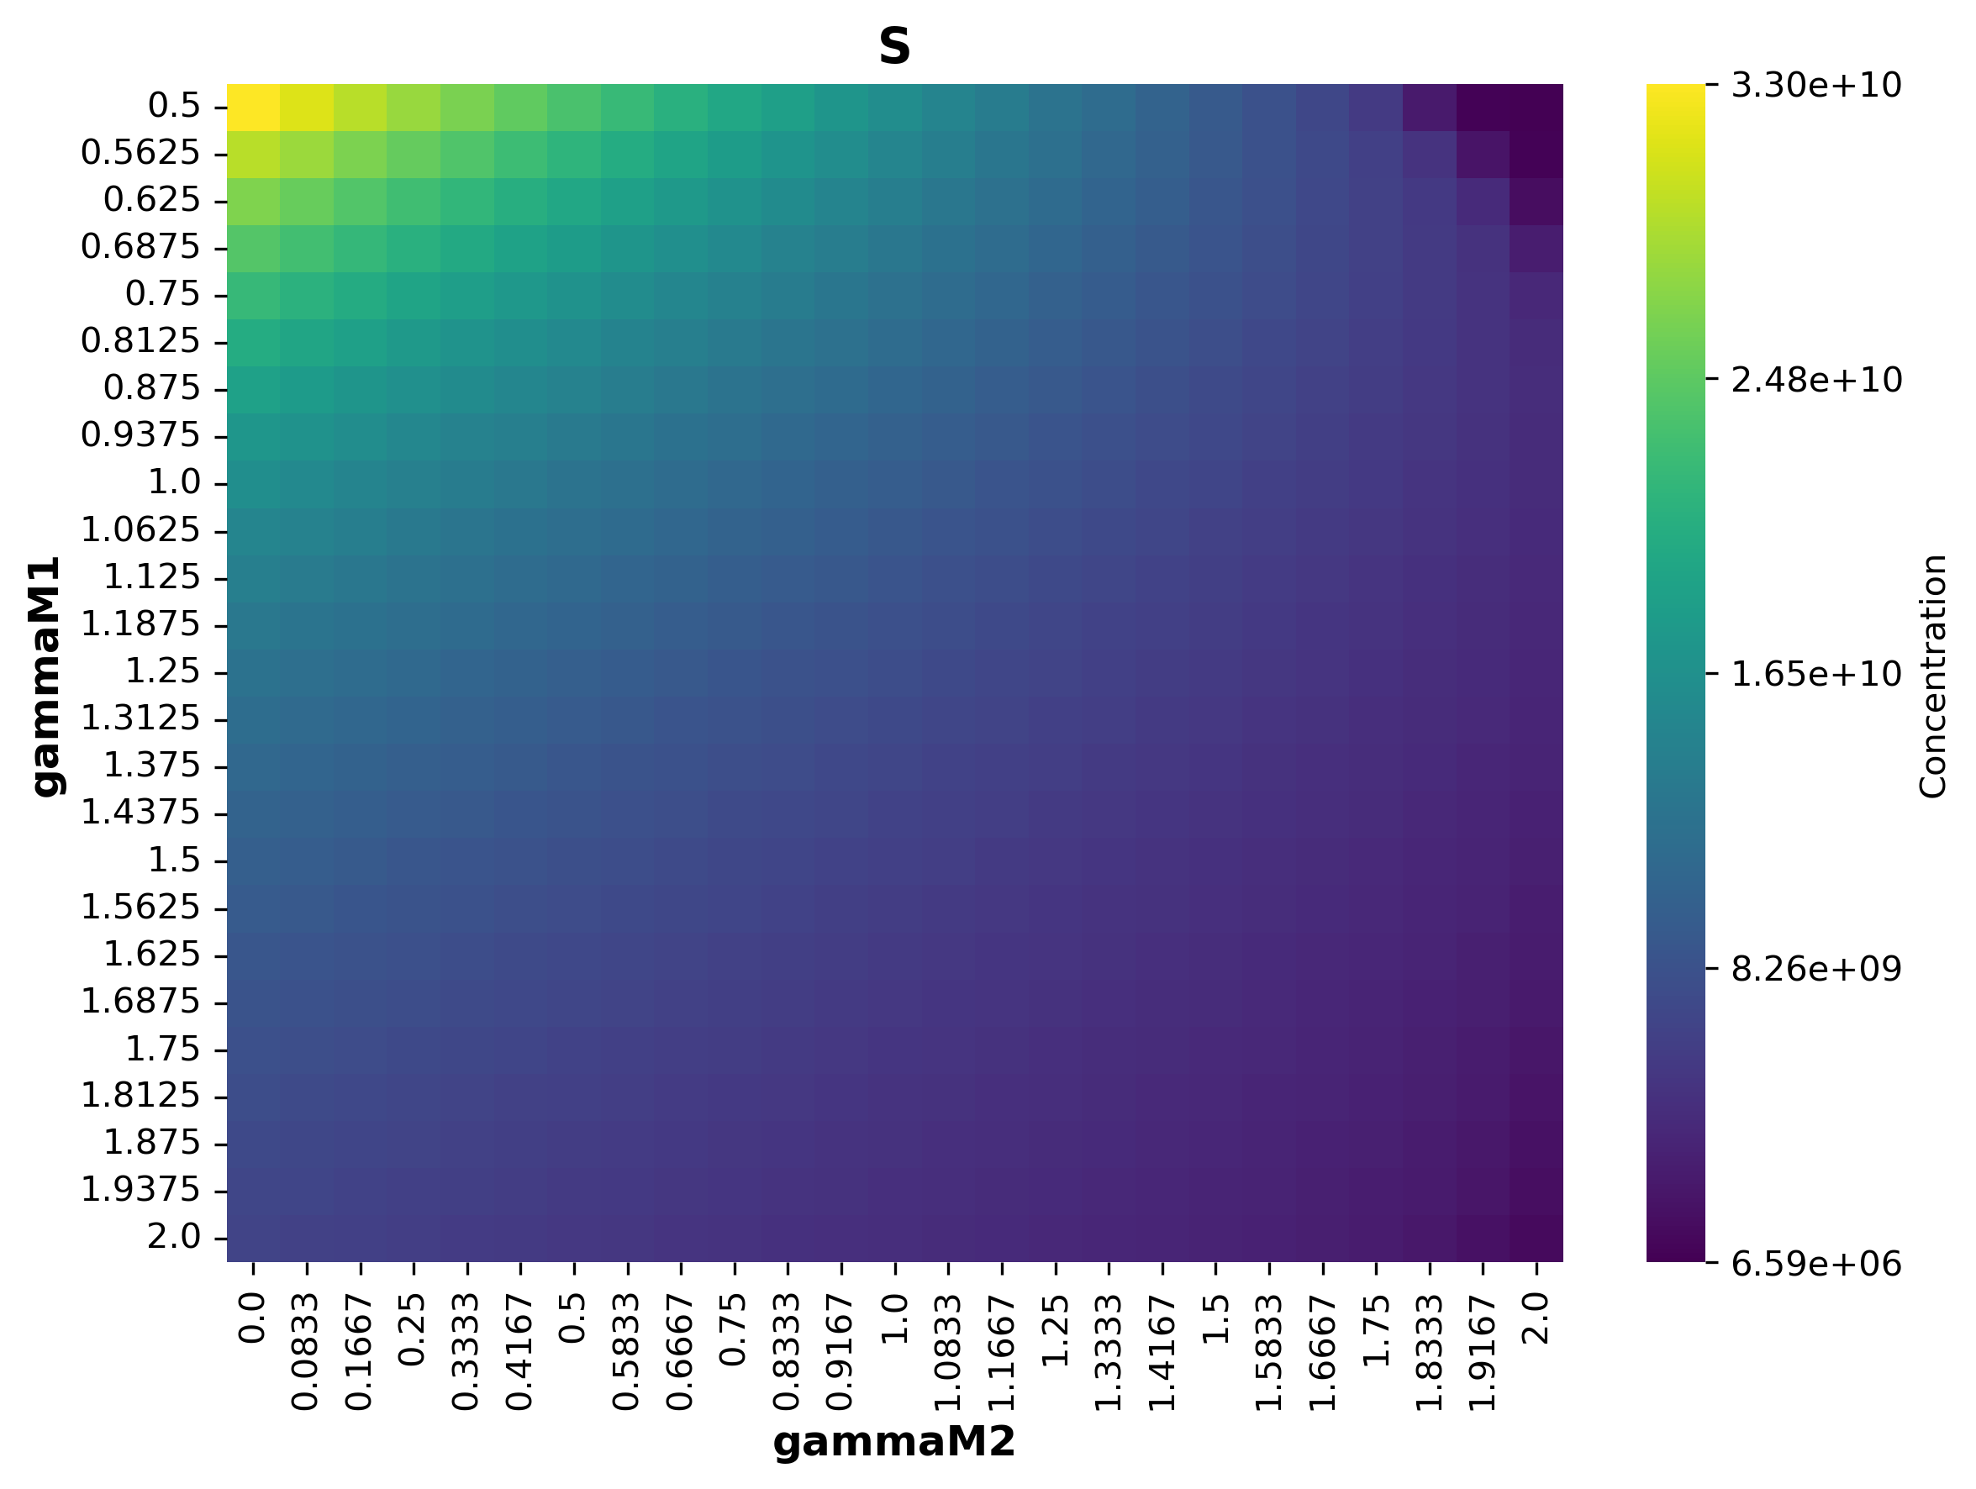
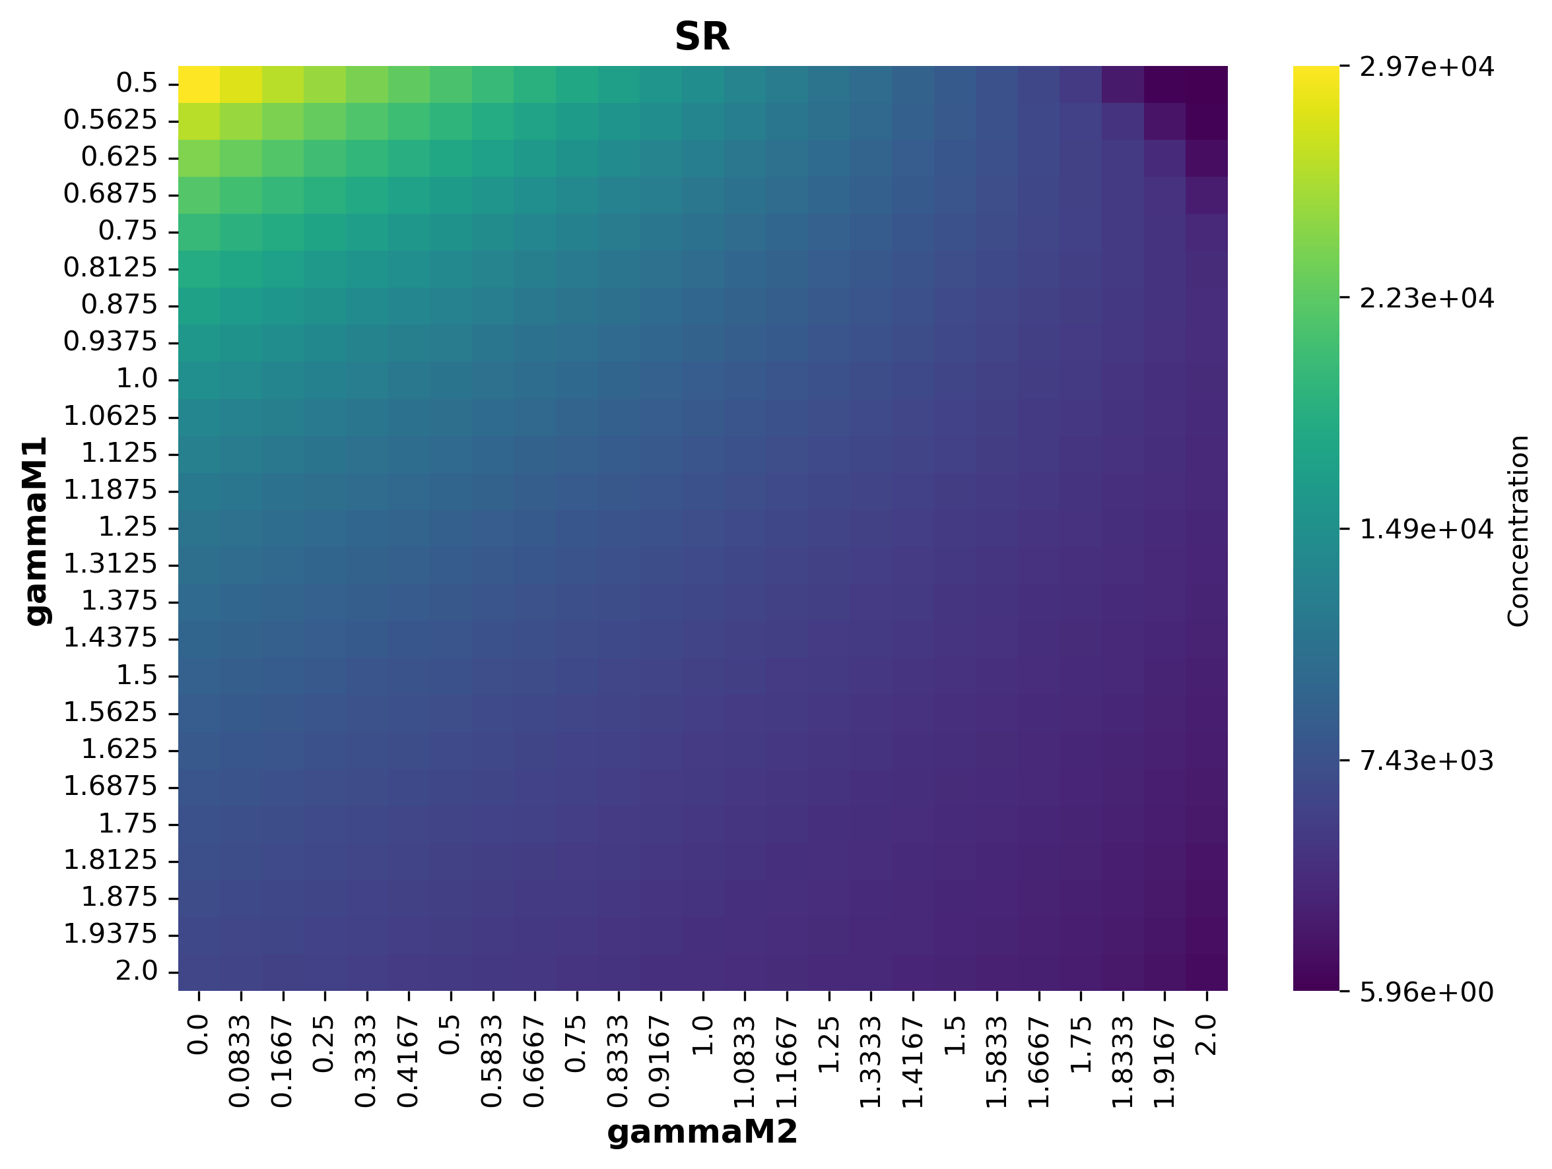
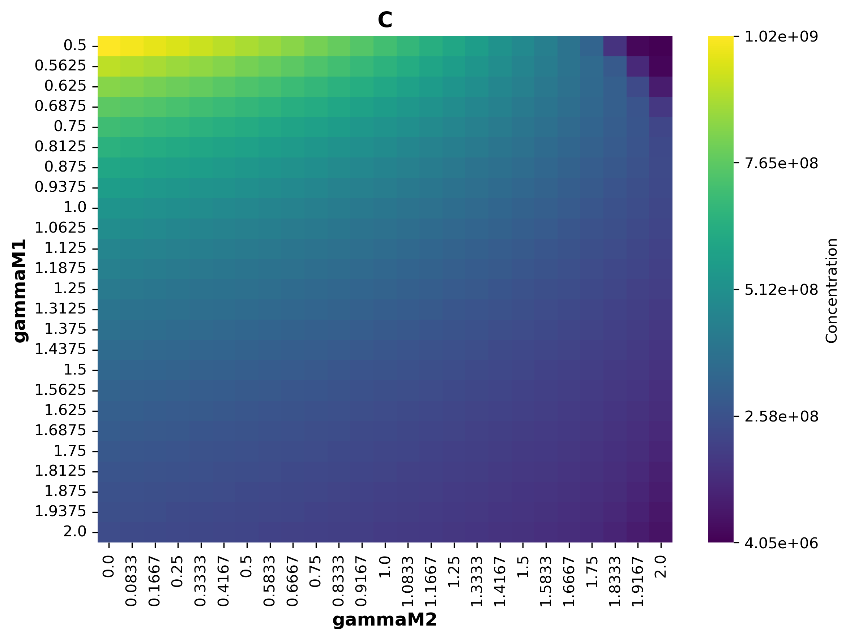
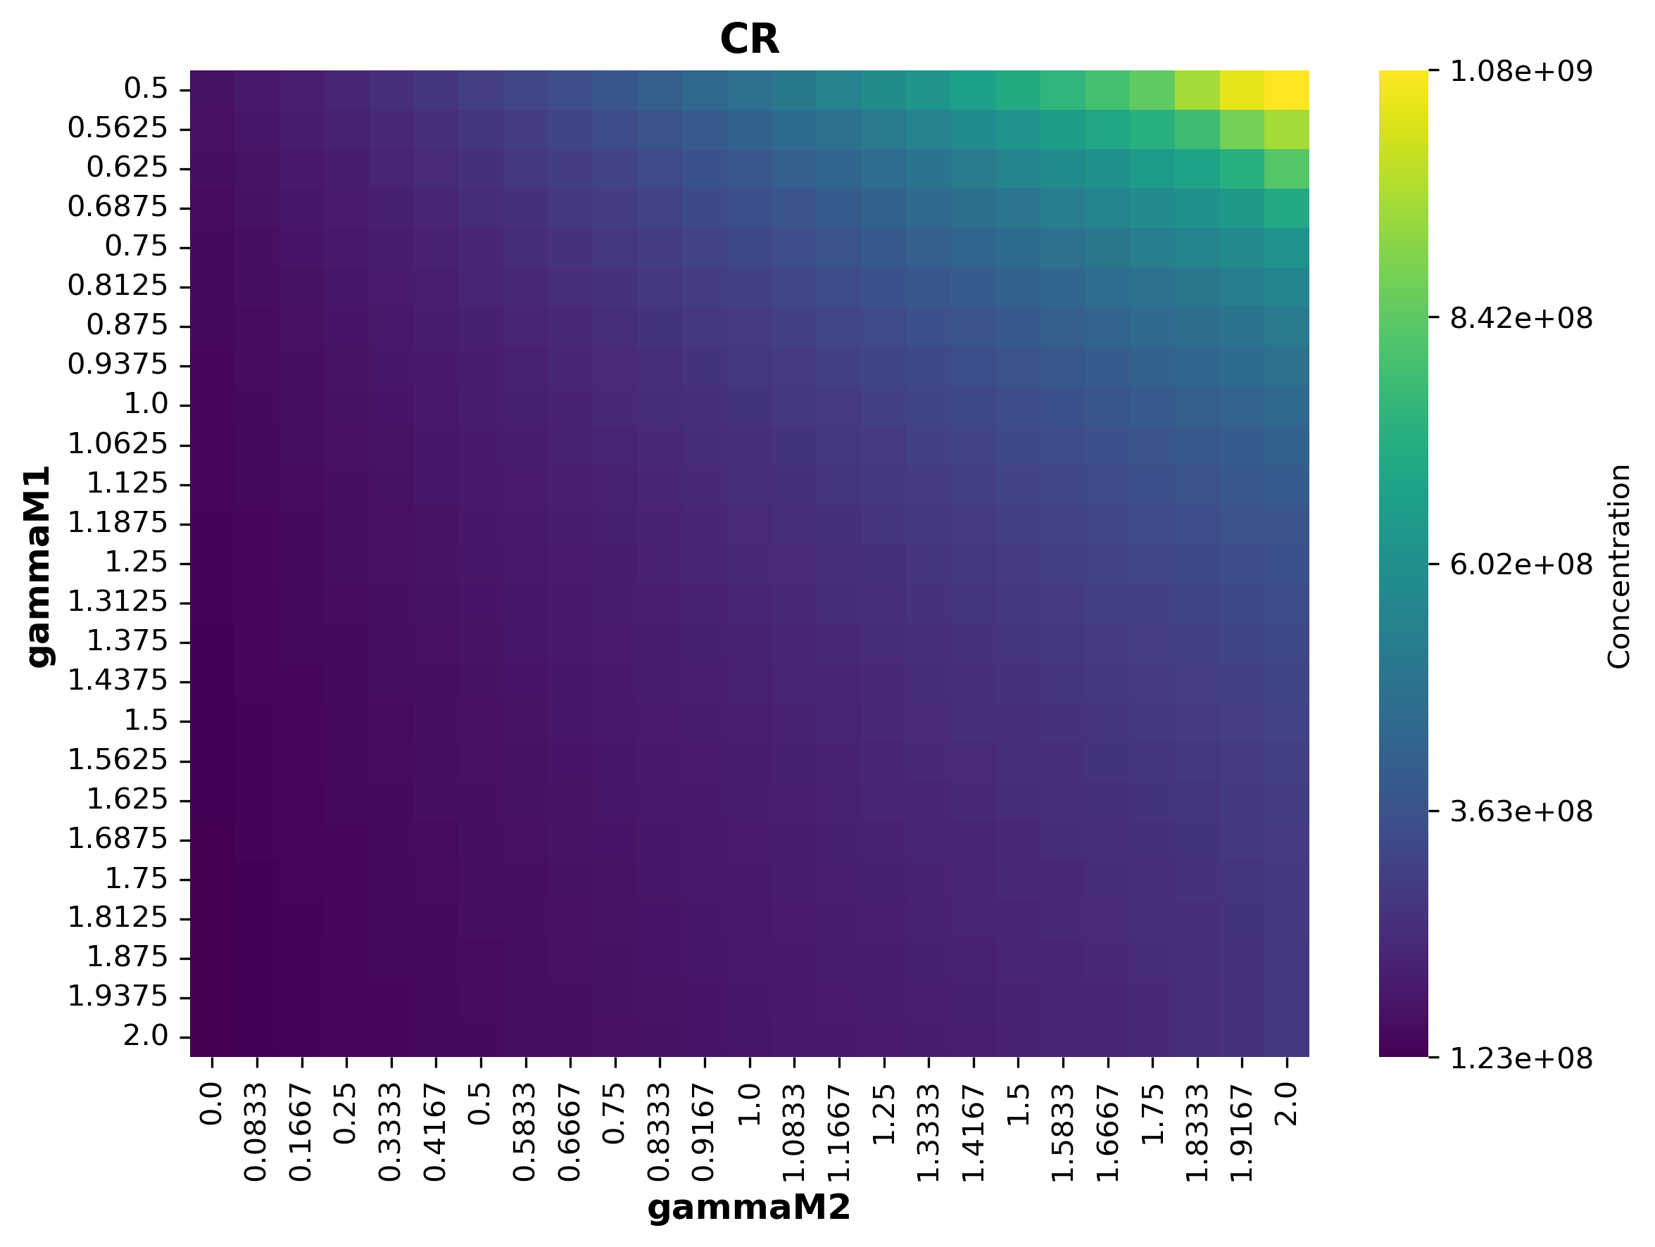
Role of the macrophage populations

Slide 18
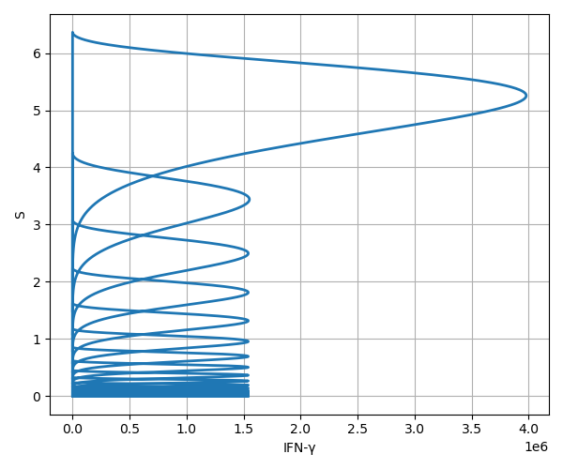
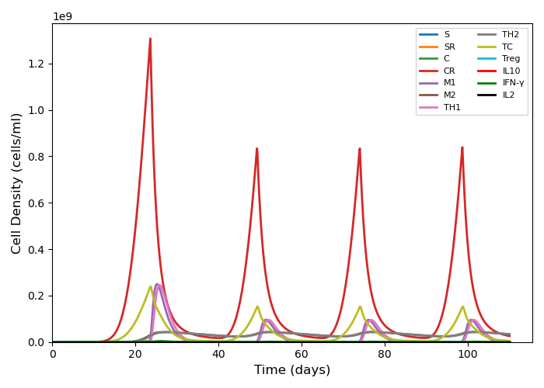
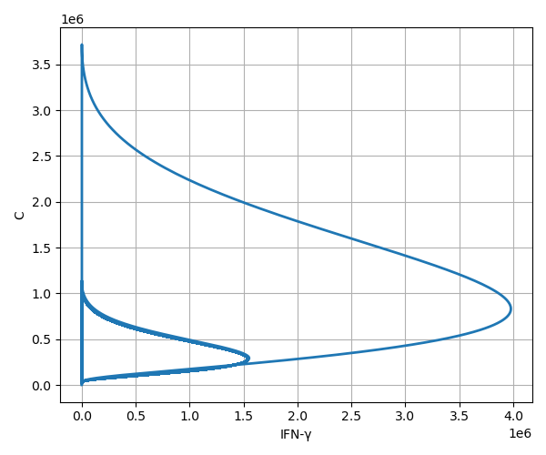
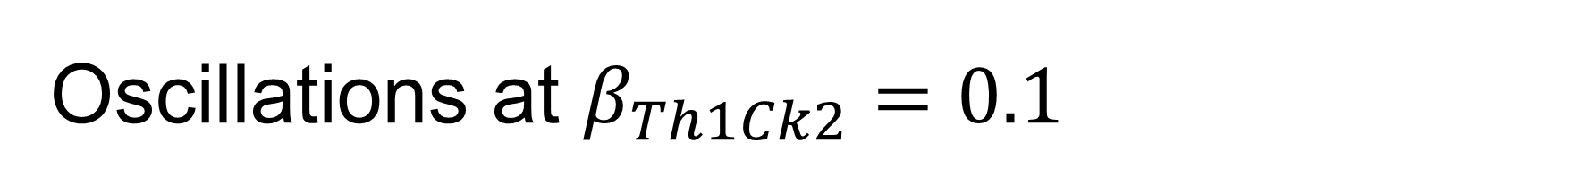
Oscillations at $β_{Th1Ck2}=0.1$

Slide 19
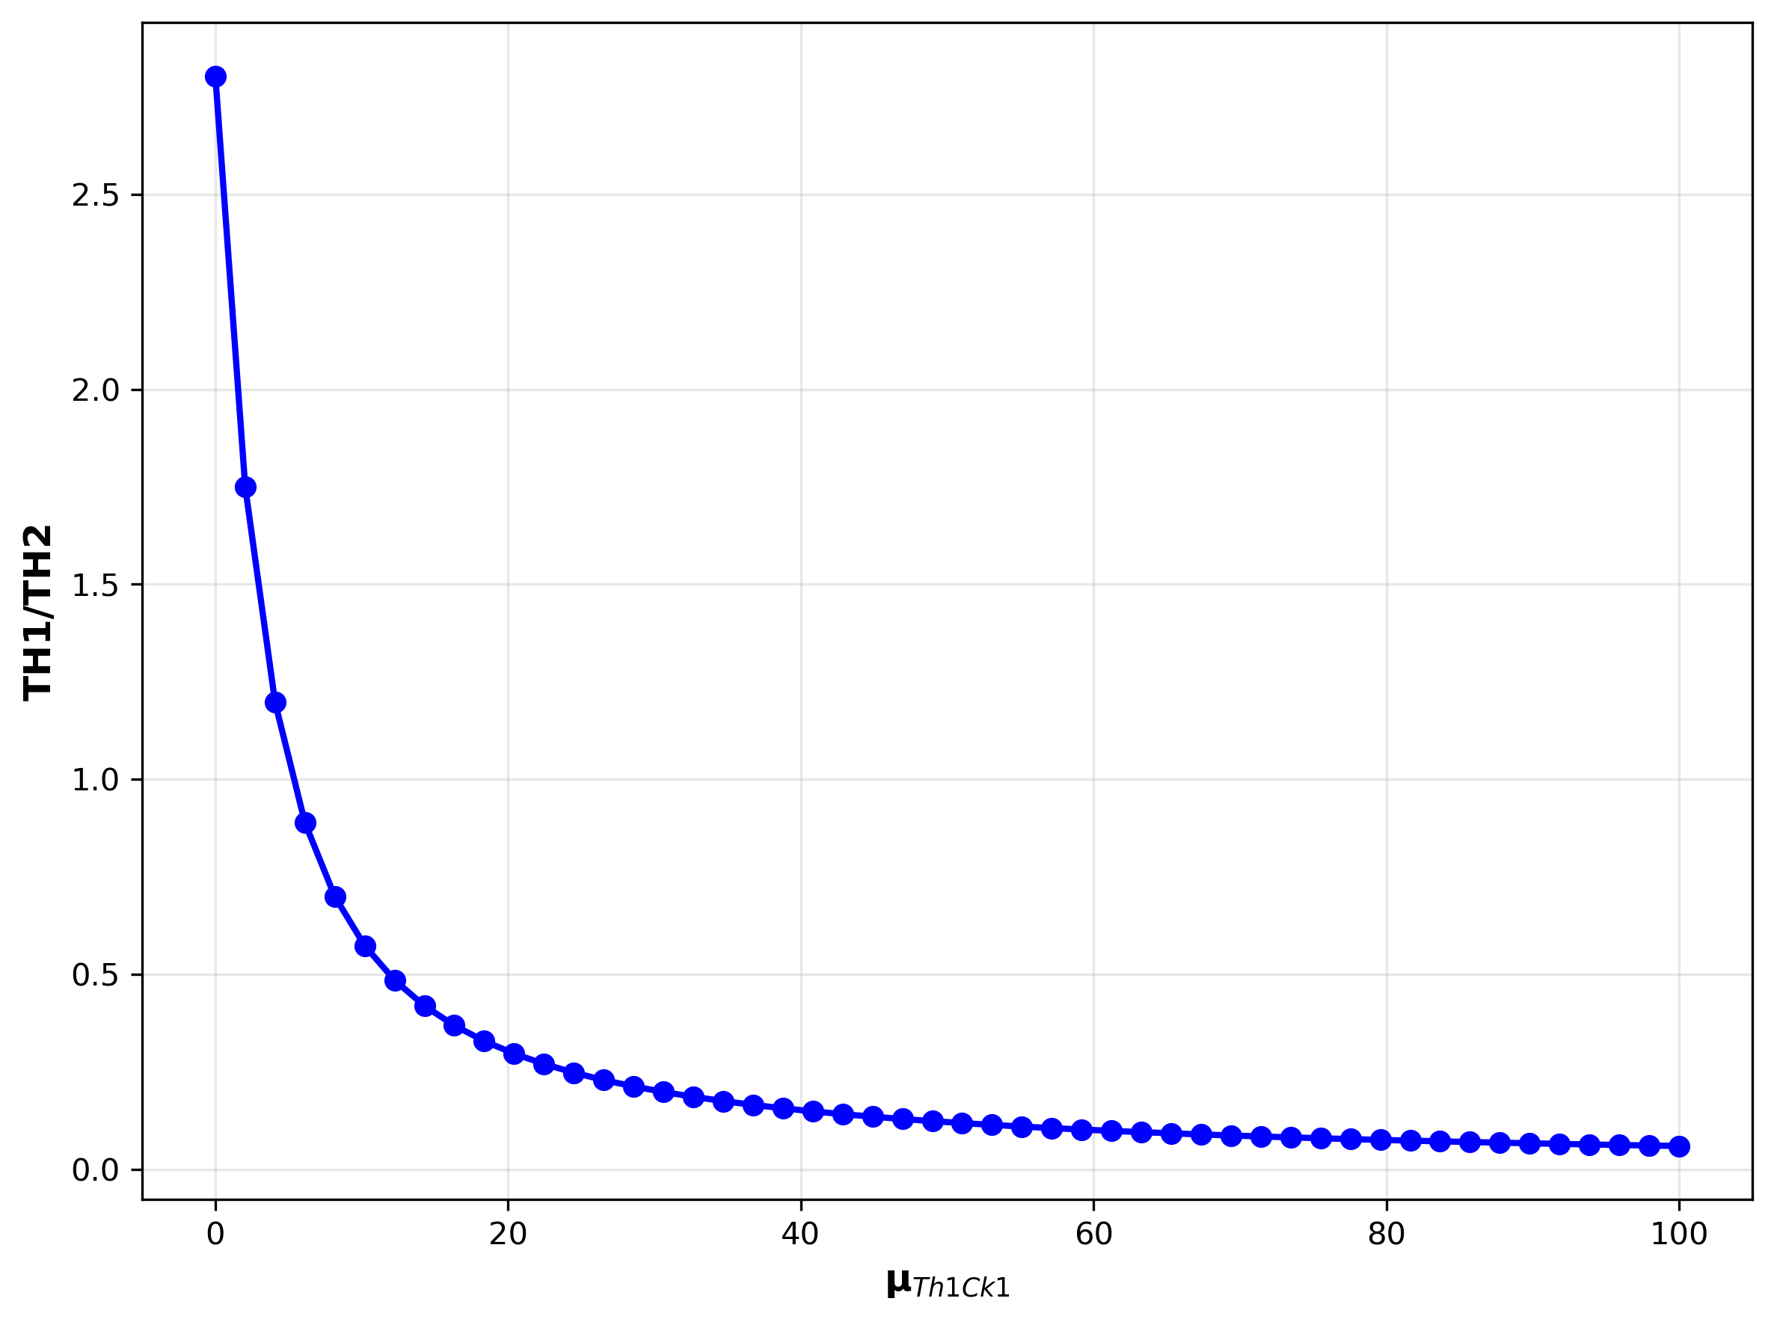
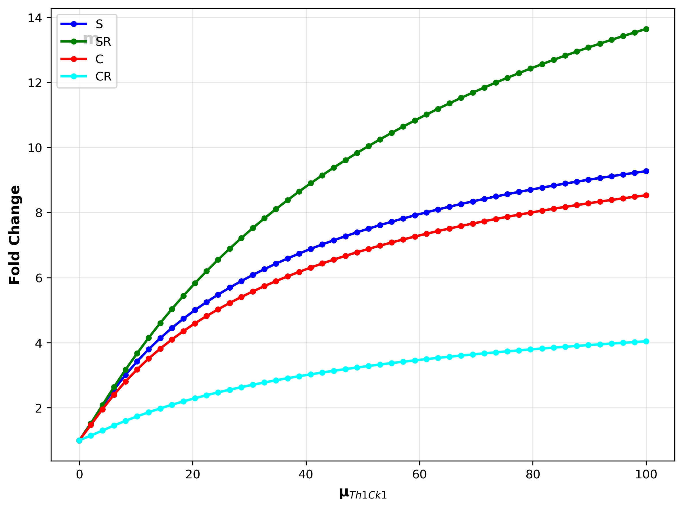
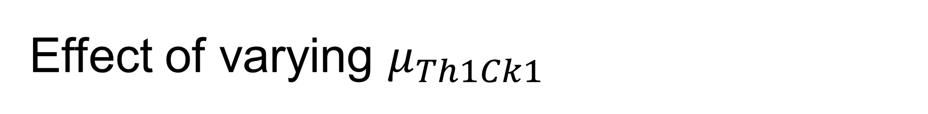
Effect of varying $μ_{Th1Ck1}$

Slide 20
Designing treatment protocols
Failure of treatment protocol 1 (only Chemo and Radiotherapy)
Control variables: u1, u2_S, u2_C
Novel treatment protocol 2 (adding in Immunotherapy)
Control variables: u3_Tc, u3_TH1

Slide 21
Probabilities of transition from regular to resistant cell types (for both Stem and Cancer cells)

Slide 22
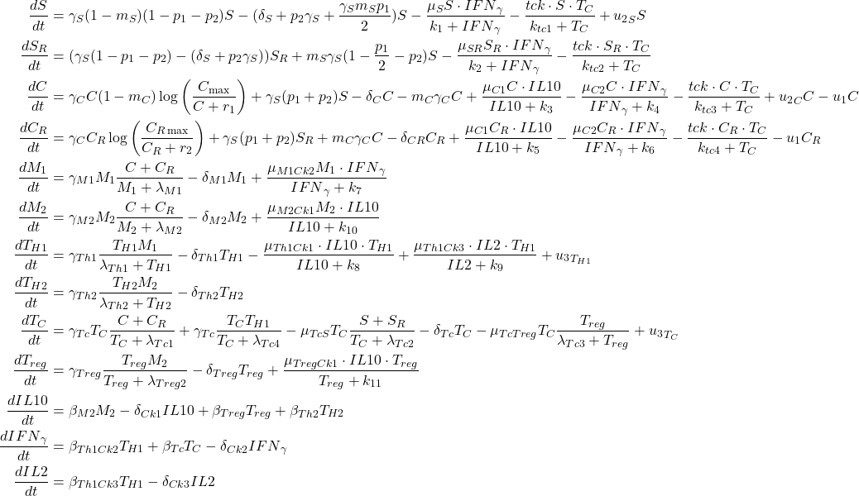
Control variables for Radiotherapy, Chemotherapy and Immunotherapy in the treatment protocols

Slide 23
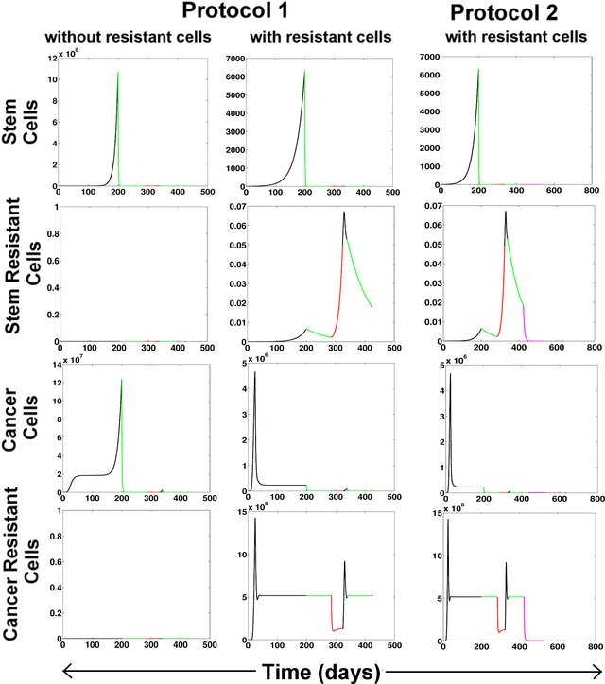

Slide 24
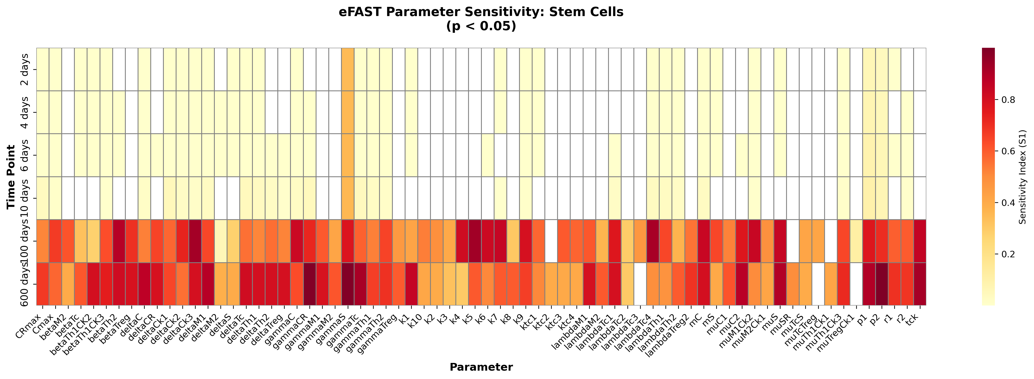
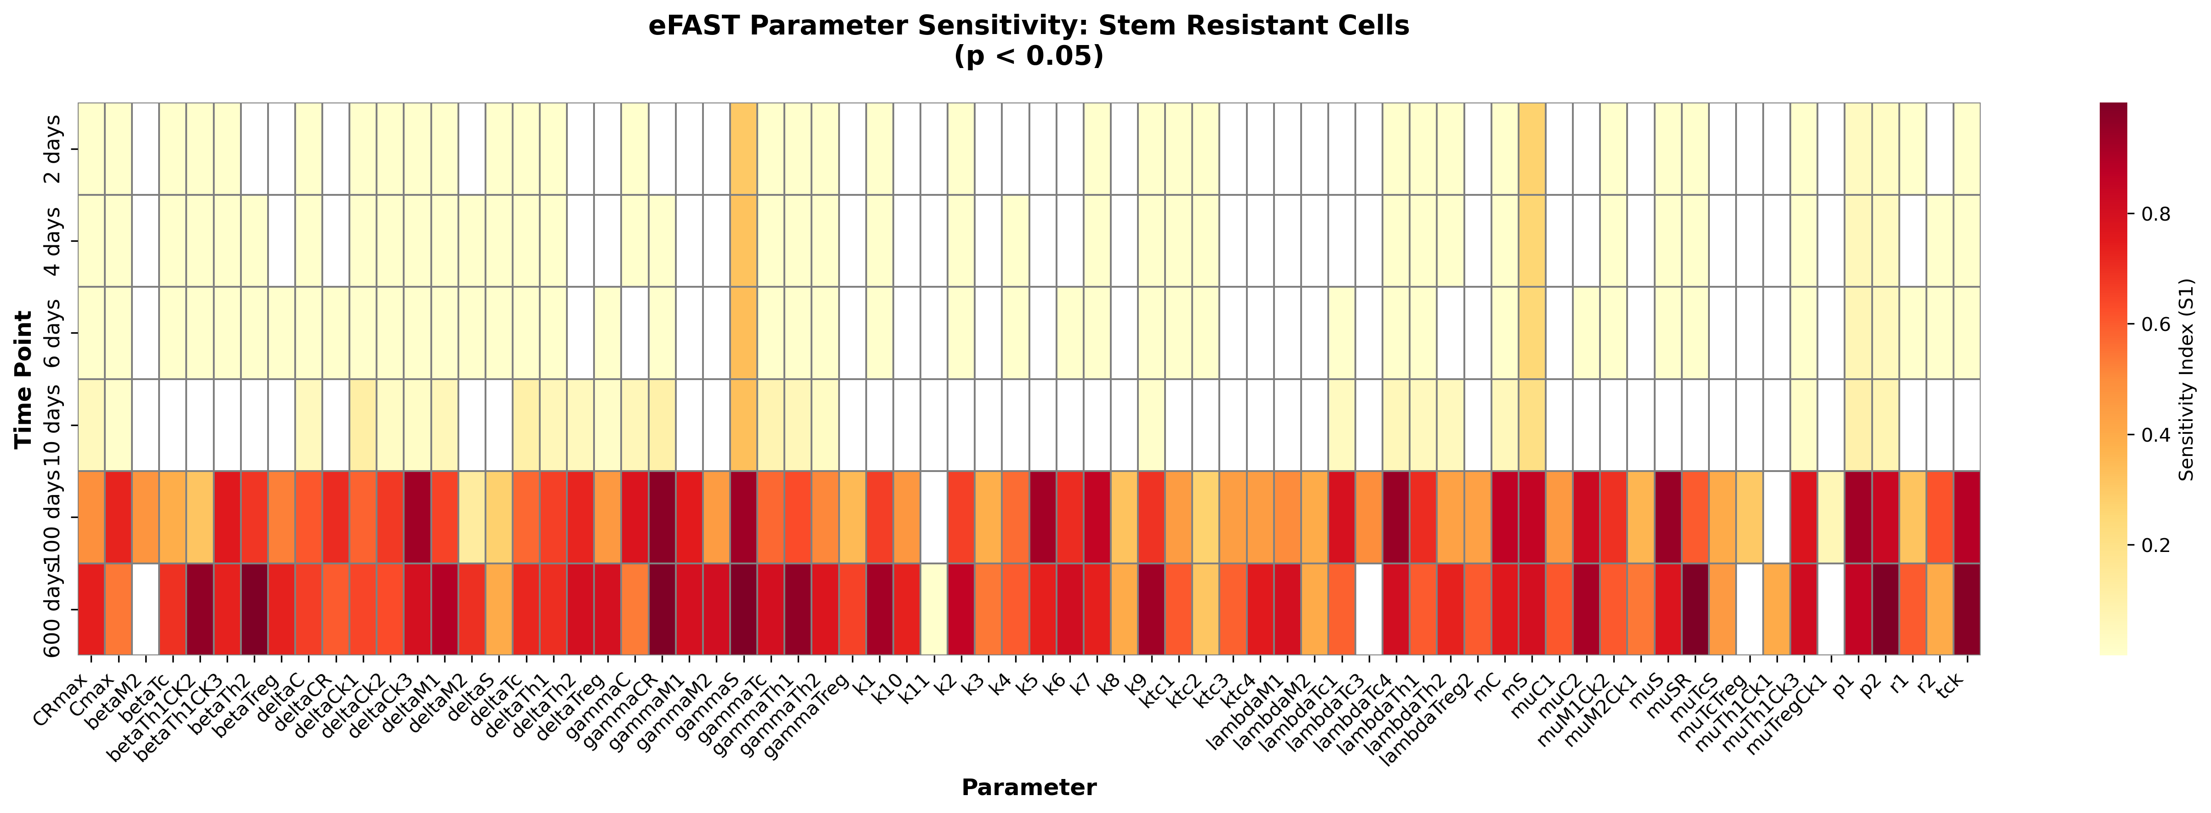
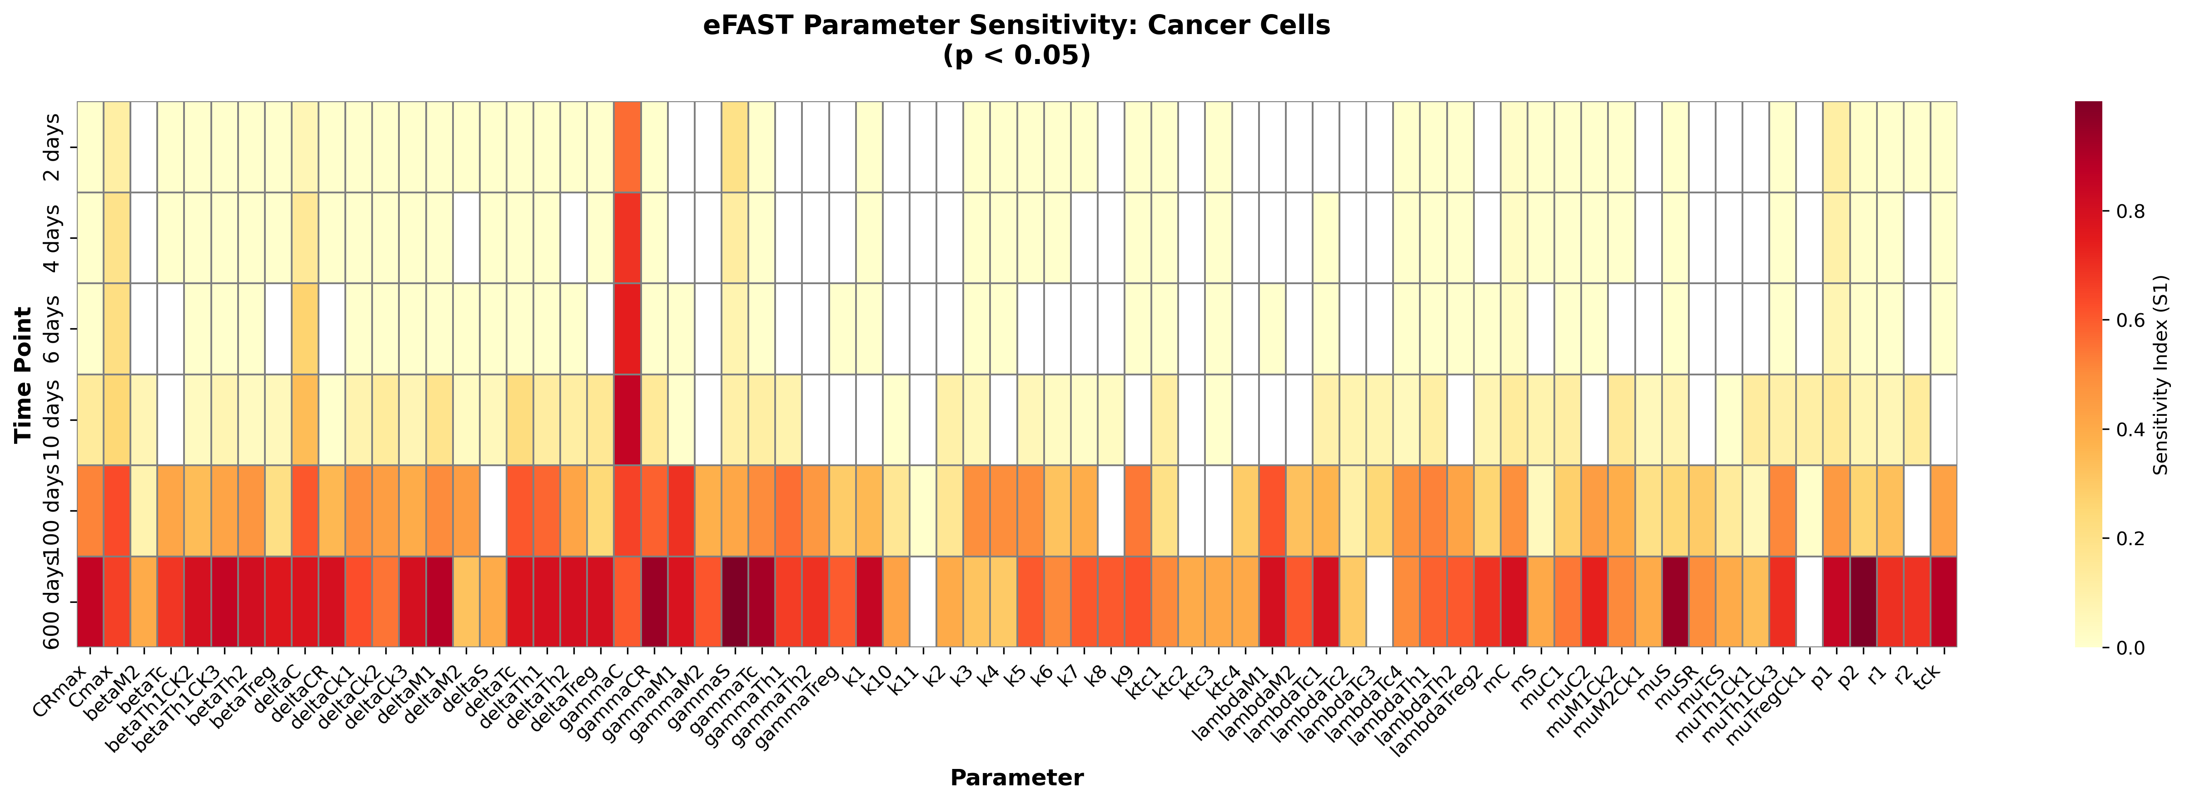
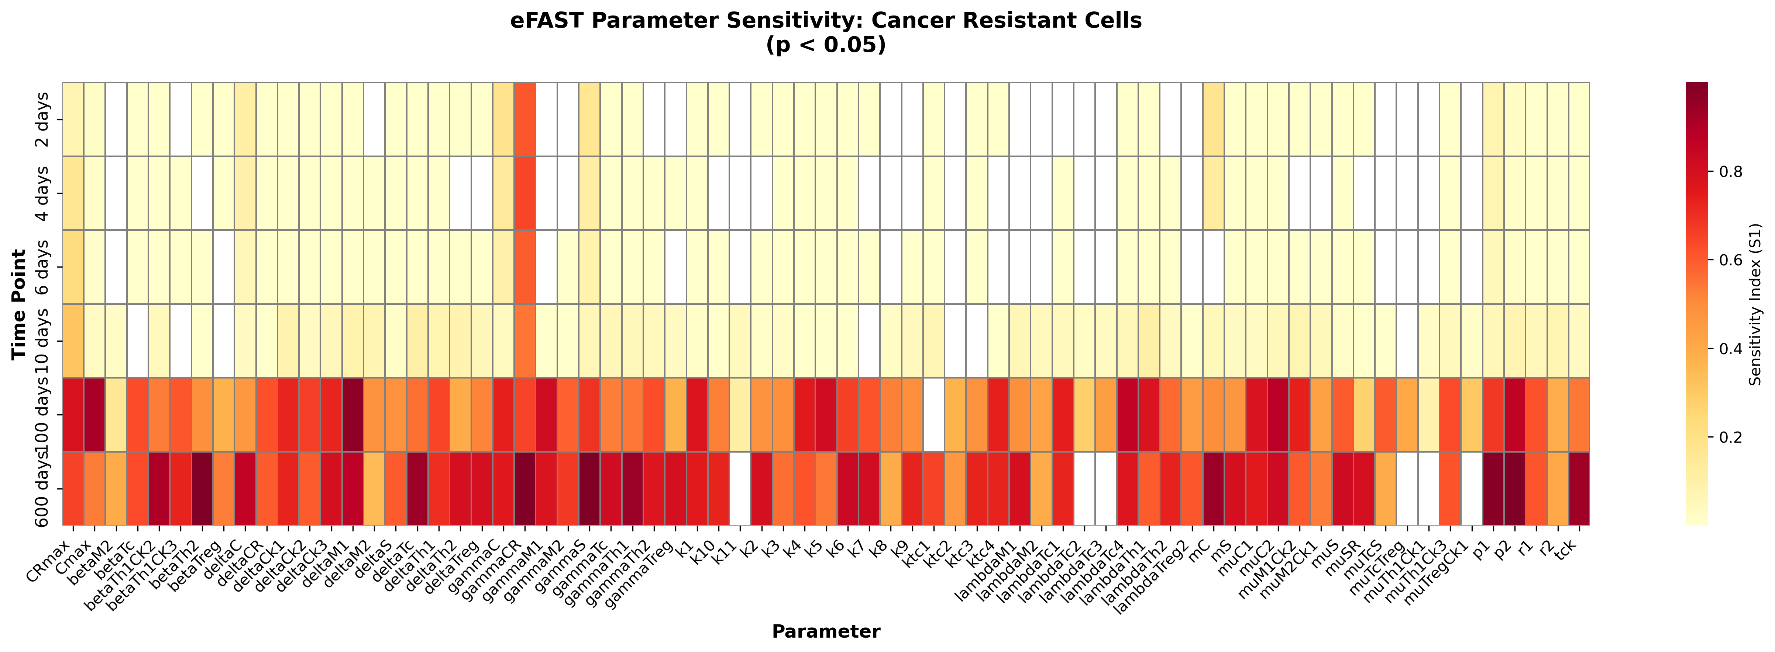
Parameter sensitivity (E-FAST algorithm)

Slide 25
future directions (tools I want to explore in the future?)
Using other aspects of the network topology itself to be able to comment on potential dynamics
Looking at spatiotemporal variation in this model (simulating this system on a lattice, for example, with ‘diffusion’)
Other treatment strategies?

